Slide 1
Prototyping MRV Systems Using Systematic and Spatially Explicit Estimates of Carbon Stock and Stock Changes in US Forestlands
Saatchi 2012 NASA-Funded CMS Project
Presented by Stephen hagen, applied geosolutions

Slide 2
Project Team
JPL/CALTECH: Sassan Saatchi, Alexander Fore, & Ziad Haddad
UCLA/IOES: Yifan Yu & Chelsea Robinson
Applied GeoSolutions: Stephen Hagen, William Salas, Jen Jenkins, & Bobby Braswell
NASA/AMES: Ramakrishna Nemani, Sangram Ganguly, & Gong Zhang
USDA Forest Service: Christopher Woodall, Grant Domke, Brian Walters, Richard Birdsey, & Kristofer Johnson
Winrock International: Tim Pearson, Nancy Harris, & Sandra Brown

Slide 3
Presentation Overview
Project Background
System components
  Carbon Stocks
  FIA-based Carbon Stock Changes
  Land Cover Change
  Logging
Carbon Flux Results

Slide 4
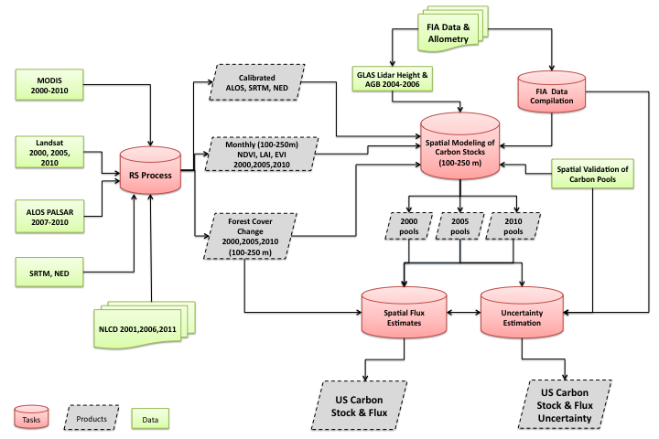
Project Background
MRV in the REDD+ context is developing rapidly
Forestlands in the US are a useful testing ground for technology
  Forest Inventory Analysis
  Fire, insect, wind, and conversion monitoring
  Harvest
  Spatially explicit carbon stocks
Create estimates of attributed carbon fluxes in US forestlands between 2005 and 2010 at 1 ha resolution with estimates of uncertainty.

Slide 5
System Components
Spatially explicit carbon stock estimates at the 1 ha resolution
  Above ground
  Below ground
  Soil
  Dead (standing, coarse debris, fine debris, litter)
Spatially explicit maps of disturbance (activity)
  Annual land cover change maps across US forestland combined with
  Maps of fire, wind, insect, forest conversion, and harvest
Summary tables of carbon stock changes derived from FIA measurements
  140,000 FIA plots were measured at two time periods.
  Allowed us to calculate Δcarbon in above/below ground carbon pools under different conditions

Slide 6
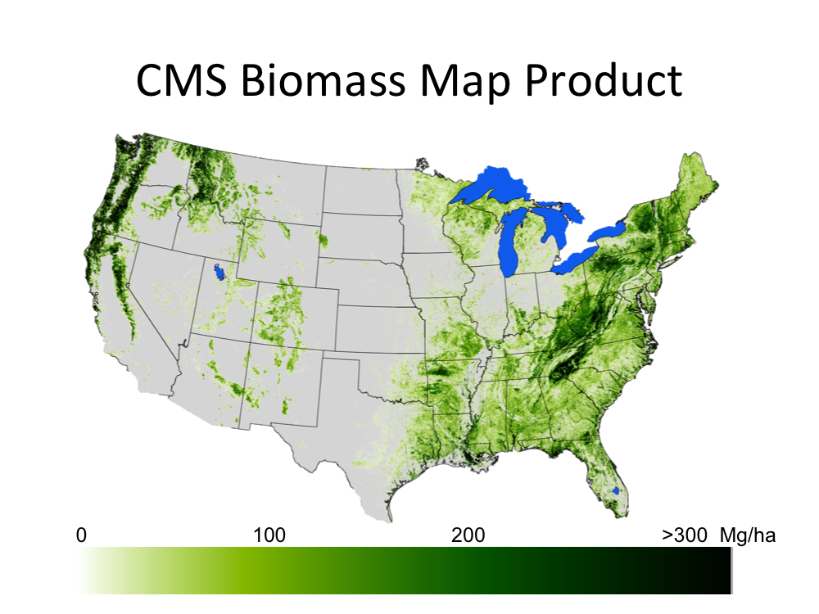
Carbon Stock Maps
County comparison with FIA data

Slide 7
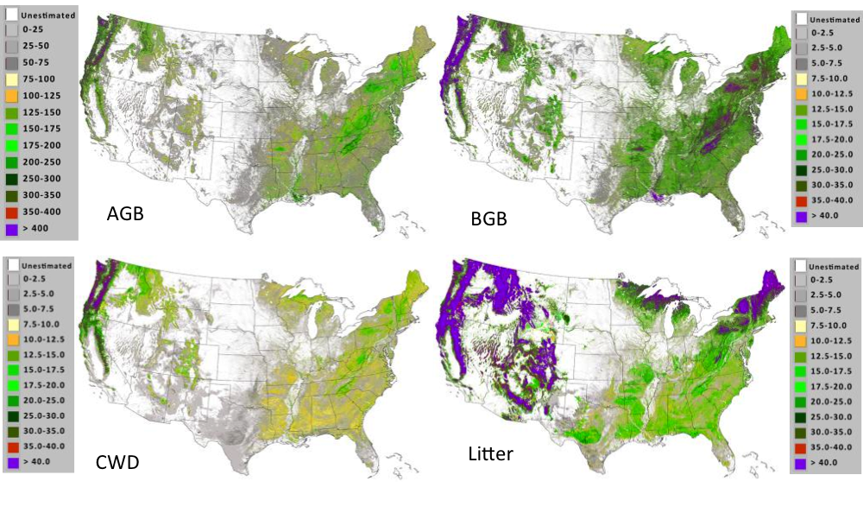
Carbon Stock Maps

Slide 8
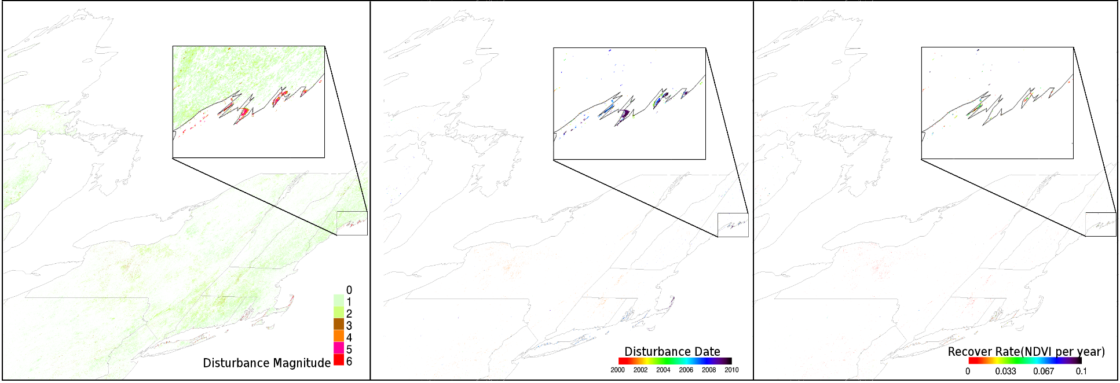
Land Cover Change
  Break detection For Additive Season and Trend (BFAST)
  MODIS MOD13Q1 250-m 16-day Vegetation Index
  2001 till present
  Disturbance Magnitude, Date, and Recovery Rate

Slide 9
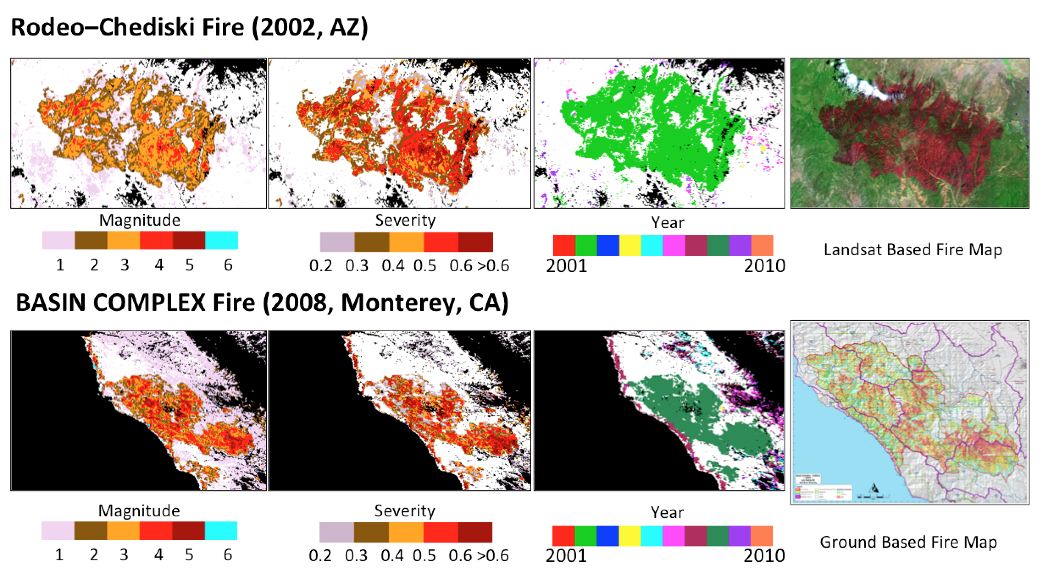
Validation of MODIS disturbance metrics with Landsat and Ground fire maps
MODIS derived products on the location, magnitude, severity, and year of disturbance compared with Landsat based fire map as well as ground based fire map for two major fire events.

Slide 10
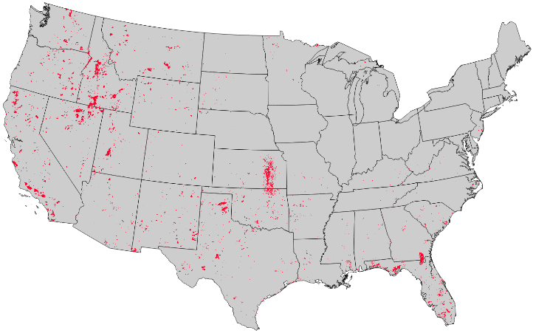
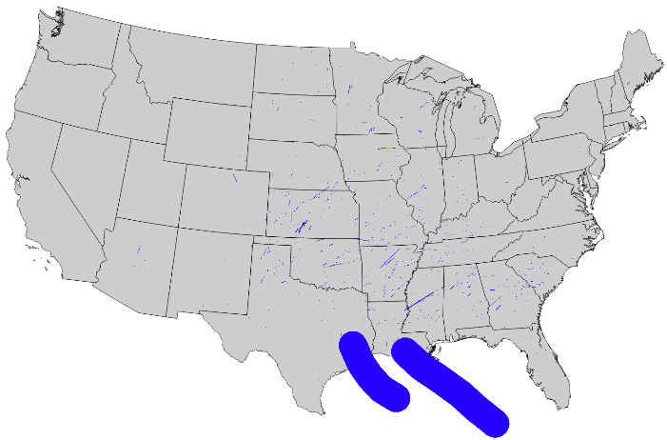
Land Cover Change
Forest cover change: Hansen et al. Global Forest Change data 2006-2010
Attribution:
  Fire: Monitoring Trends In Burn Severity (MTBS) 2006-2010 maximum burn severity
  Insect: Aerial Detection Survey (ADS) 2006-2010 total trees per acre
  Wind: Tornado and hurricane tracks from NOAA 2006-2010
  Conversion: National Land Cover Data (NLCD) 2006-2011, adjusted
  Harvest: USFS Timber Product Output (TPO) data at the county+ scale from 2007
Fire
Wind

Slide 11
FIA-based Delta Carbon Tables
141,000 FIA repeated observations.
Separated in to “Disturbed” and “Undisturbed” tables
Disturbed further separated by
  Region (North, South, West)
  Forest type (hardwood, softwood)
  Disturbance type (fire, wind, insect, conversion, harvest)
  Disturbance intensity (low, medium, high)
Undisturbed further separated by
  Region (North, South, West)
  Forest type (hardwood, softwood)
  Initial above ground carbon (4 categories)
  Drought status (Yes, No)
FIA-based annual changes in carbon pools by category
Region | ForestType | Disturbance | Intensity | Nplots | agc | bgc
North | softwood | insect | low | 49 | -0.8% | -0.8%
North | softwood | insect | medium | 82 | -4.4% | -4.6%
North | softwood | insect | high | 45 | -12.6% | -13.3%
North | softwood | fire | low | 1 | -1.1% | -1.0%
North | softwood | fire | medium | 3 | -5.2% | -5.3%
North | softwood | fire | high | 5 | -15.0% | -15.7%
North | softwood | weather | low | 27 | -1.0% | -1.1%
North | softwood | weather | medium | 33 | -4.3% | -4.6%
North | softwood | weather | high | 21 | -13.1% | -13.9%
North | softwood | other | low | 3 | -0.6% | -0.7%
North | softwood | other | medium | 3 | -4.9% | -5.1%
North | softwood | other | high | 2 | -11.1% | -12.0%
North | softwood | cut | low | 105 | -1.0% | -1.1%
North | softwood | cut | medium | 307 | -5.5% | -5.7%
North | softwood | cut | high | 302 | -14.3% | -14.8%

Slide 12
Carbon Flux Map Framework
Modular framework
  As data sets improve, results will improve
  Test effects of using different data sets.
    Our FIA-tables vs. Smith et al growth tables
    Hansen maps of disturbance vs. Sangram’s maps
    Other forest carbon stock maps
  Monte Carlo uncertainty analysis

Slide 13
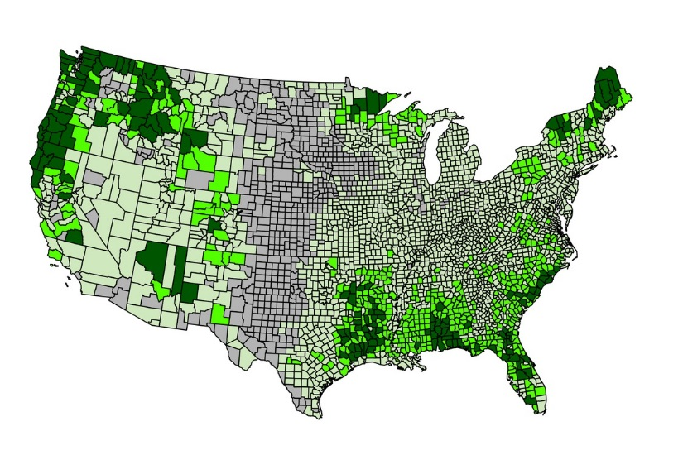
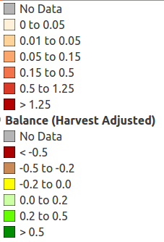
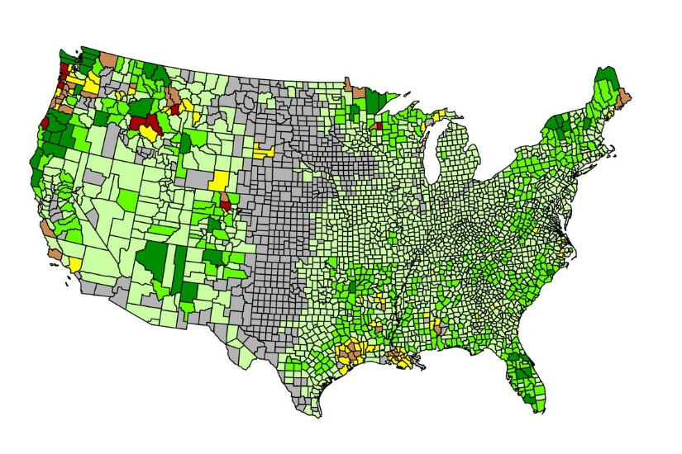
2005-2010 Carbon Flux in US Forests
PRELIMINARY RESULTS:
Gross sequestration: 487 Tg C/year [435-542]
Gross committed emissions: 231 Tg C/year [226-250]
Net flux (committed): 256 Tg C/year (sink) [199-313]
Emission attribution (% of gross emissions):
  Harvest: 69%
  Converted: 6%
  Fire: 10%
  Wind: 8%
  Insect: 7%
  Drought: < 1%
Gross Sequestration
Tg C/year
(negative to atm.)
Anthropogenic (75%)
Natural (25%)
Net Flux

Slide 14
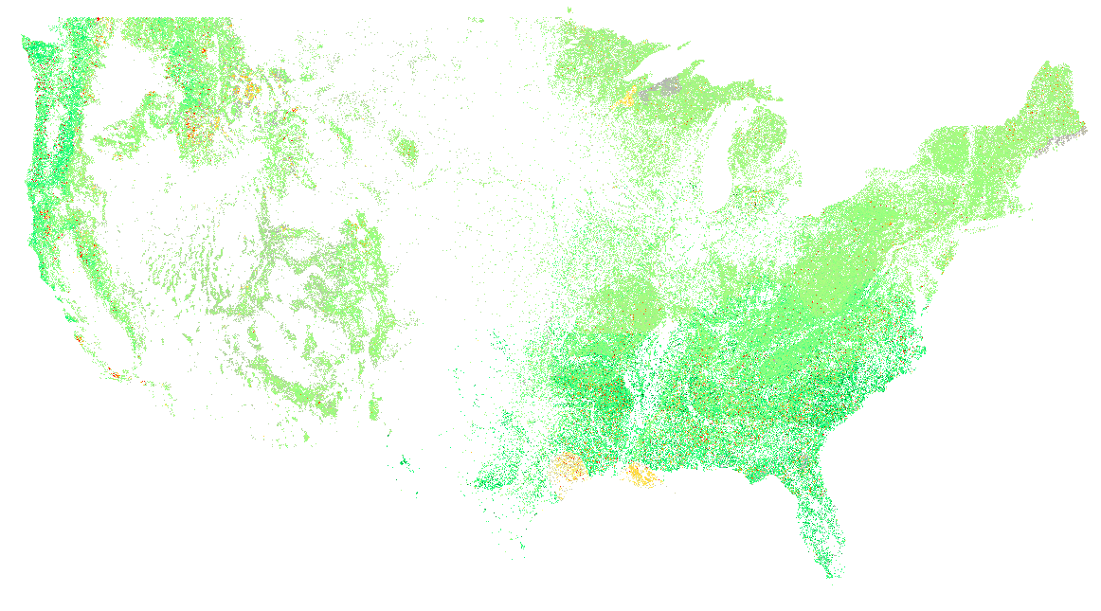
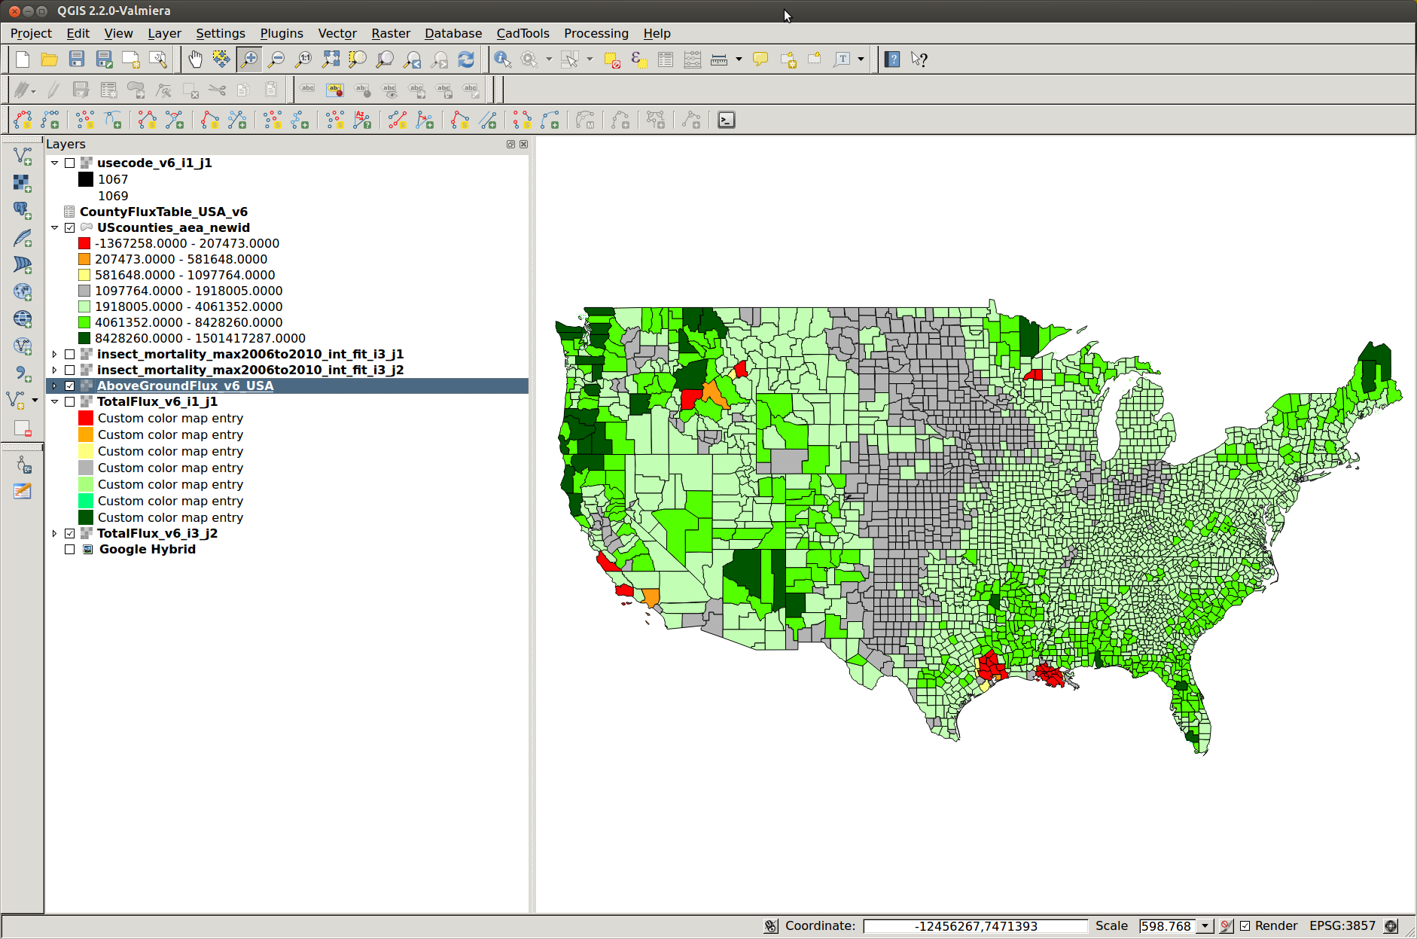
Multiple Scales
Large source
Moderate source
Small source
Carbon neutral
Small sink
Moderate sink
Large sink

Slide 15
Attribution Example: Tornado

Slide 16
Attribution Example: Fire/Insect

Slide 17
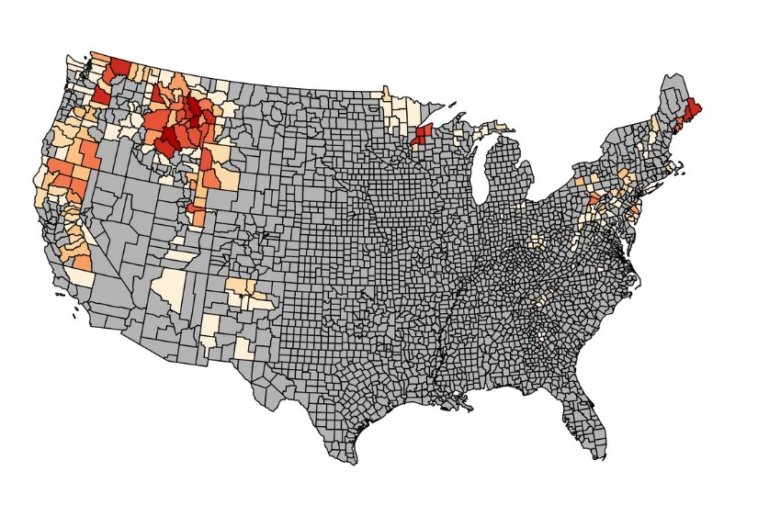
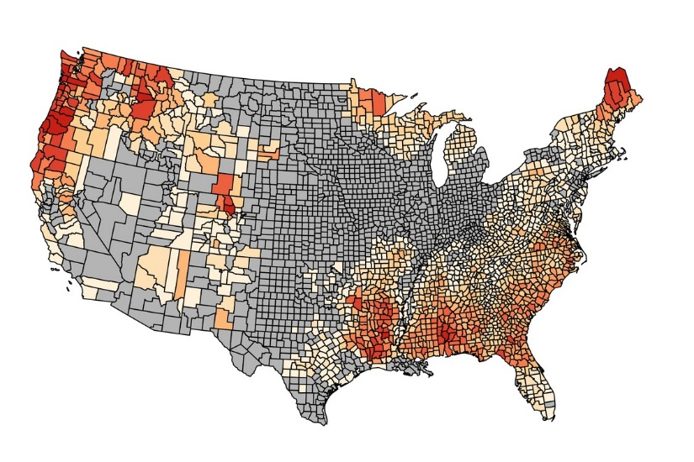
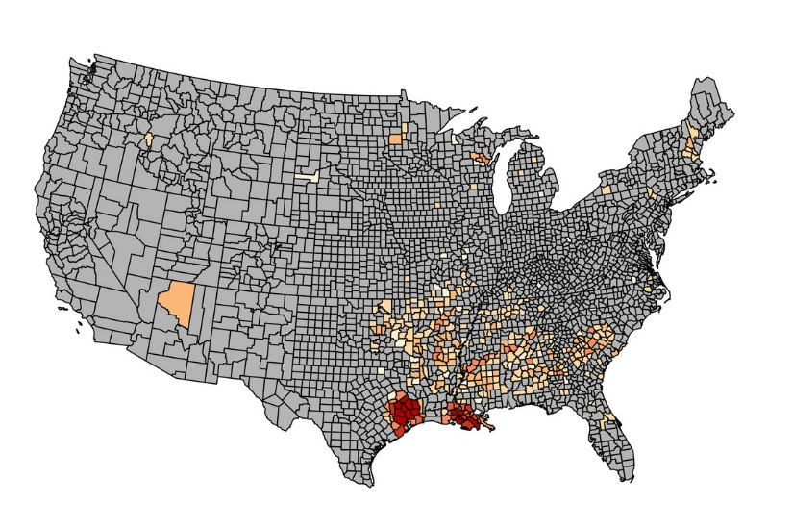
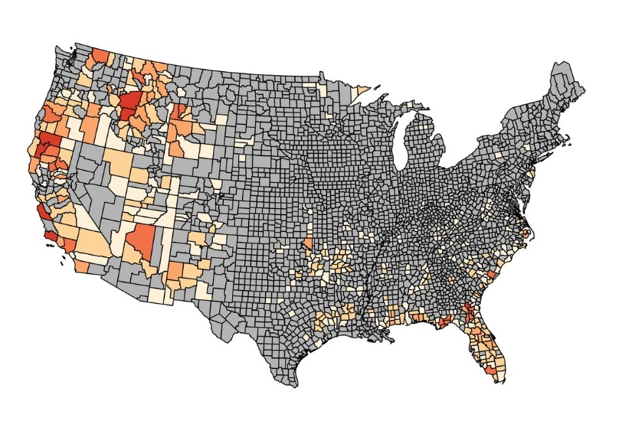
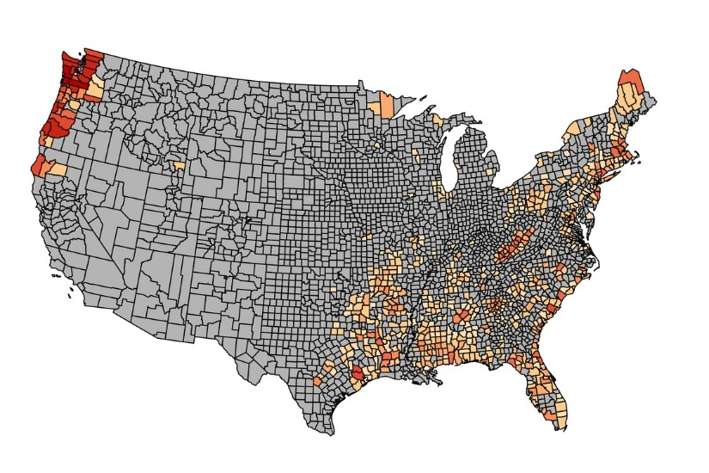
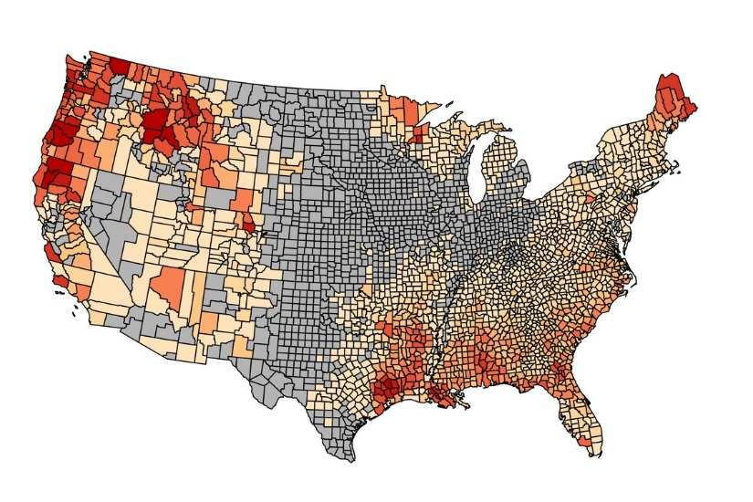
2005-2010 Carbon Flux in US Forests
Insect
Harvest
Wind
Tg C/year
(positive to atm.)
Fire
Conversion
Gross Emissions

Slide 18
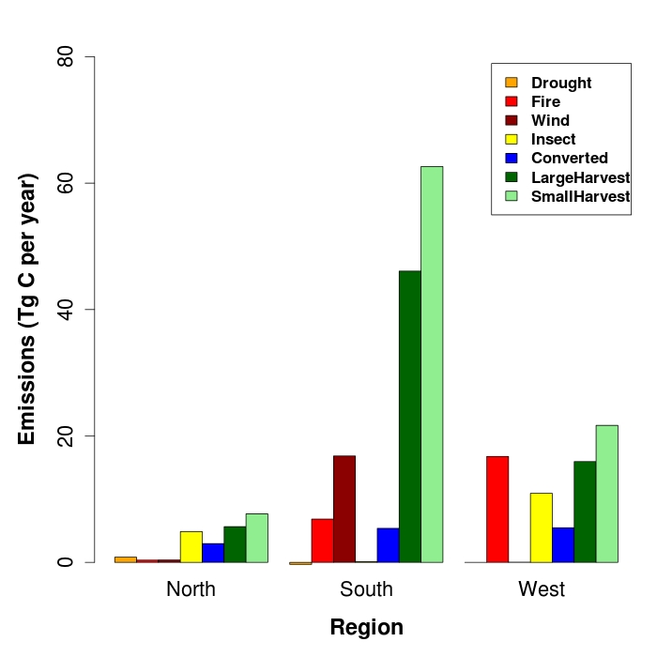
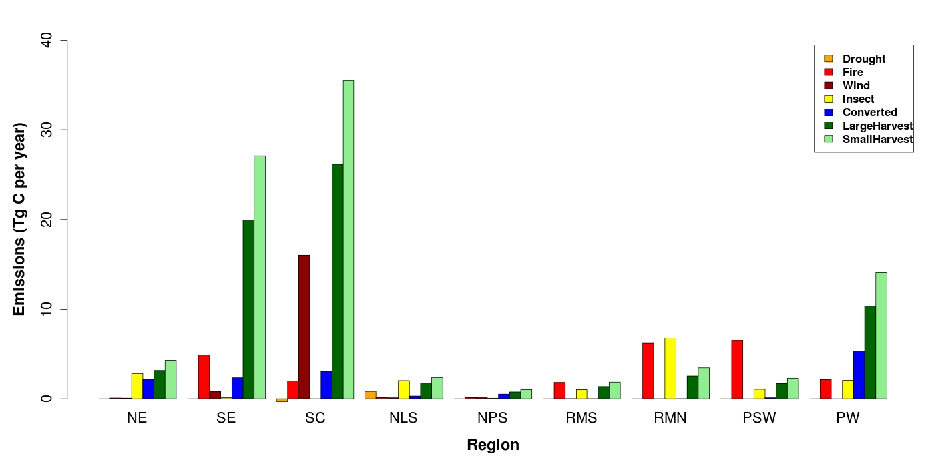
2005-2010 Carbon Flux in US Forests

Slide 19
Comparison With Other Estimates
Net sequestration:
  This study: 256 Tg C/year 2005-2010
  2010 US Greenhouse Gas Inventory: sequestered 293 Tg C/year in 2010
  Zheng et al. 2011: sequestered 181 Tg C/year 1991-2001
Emissions from fire:
  This study: 20 Tg C/year 2005-2010
  2010 US Greenhouse Gas Inventory: 32 Tg C/year 2007-2010
  Zheng et al. 2011: 9 Tg C/year 1991-2001
  Williams et al. 2012: 10 Tg C/year 2005
Gross emissions:
  This study: 231 Tg C/year 2005-2010
  Powell et al 2014: 61 – 84 Tg C/year 1986-2004

Slide 20
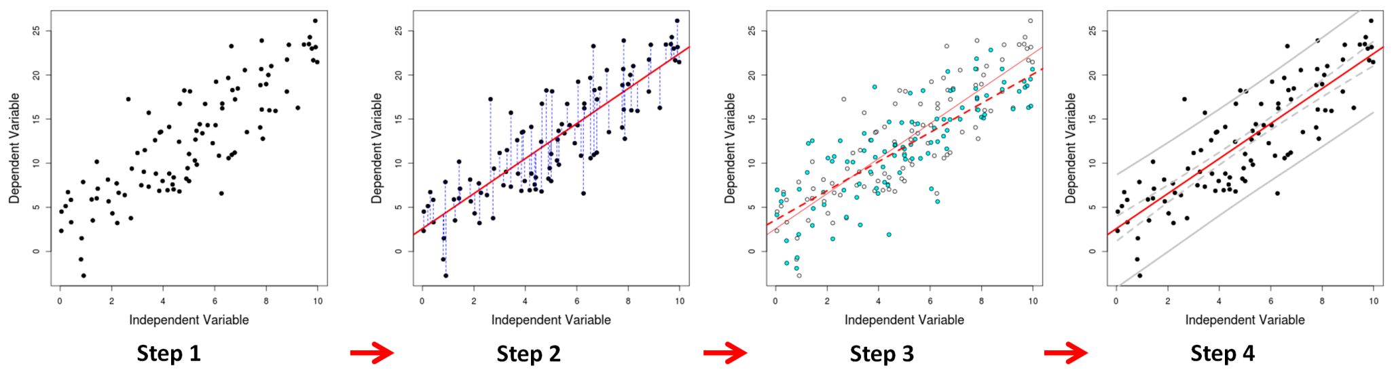
Uncertainty approach
Monte Carlo approach for estimating prediction intervals
  (Modified nonparametric residual bootstrap technique)
  Integrates uncertainty from all sources
  Requires fewer assumptions about the distribution of residuals
  Estimates effects of spatial autocorrelation of residuals and non-constant variance (heteroskedasticity)
  Provides estimates of uncertainty at any scale (pixel, county, etc.)
  Extremely data and processor heavy.

Slide 21
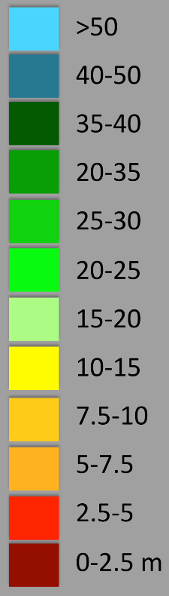
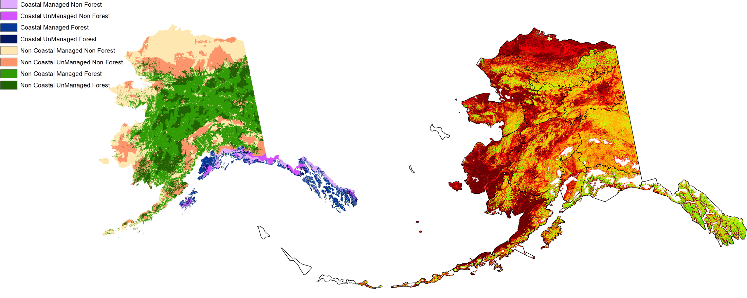
Alaska’s Vegetation Height Distribution
Distribution of Vegetation Height from GLAS Lidar Measurements at 1-ha
Saatchi and Woodall et al.

Slide 22
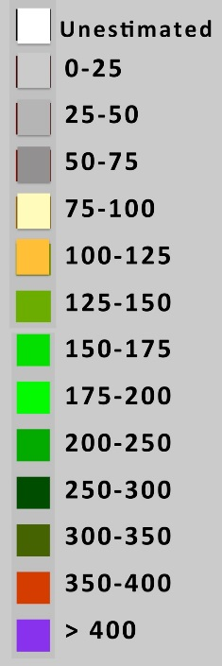
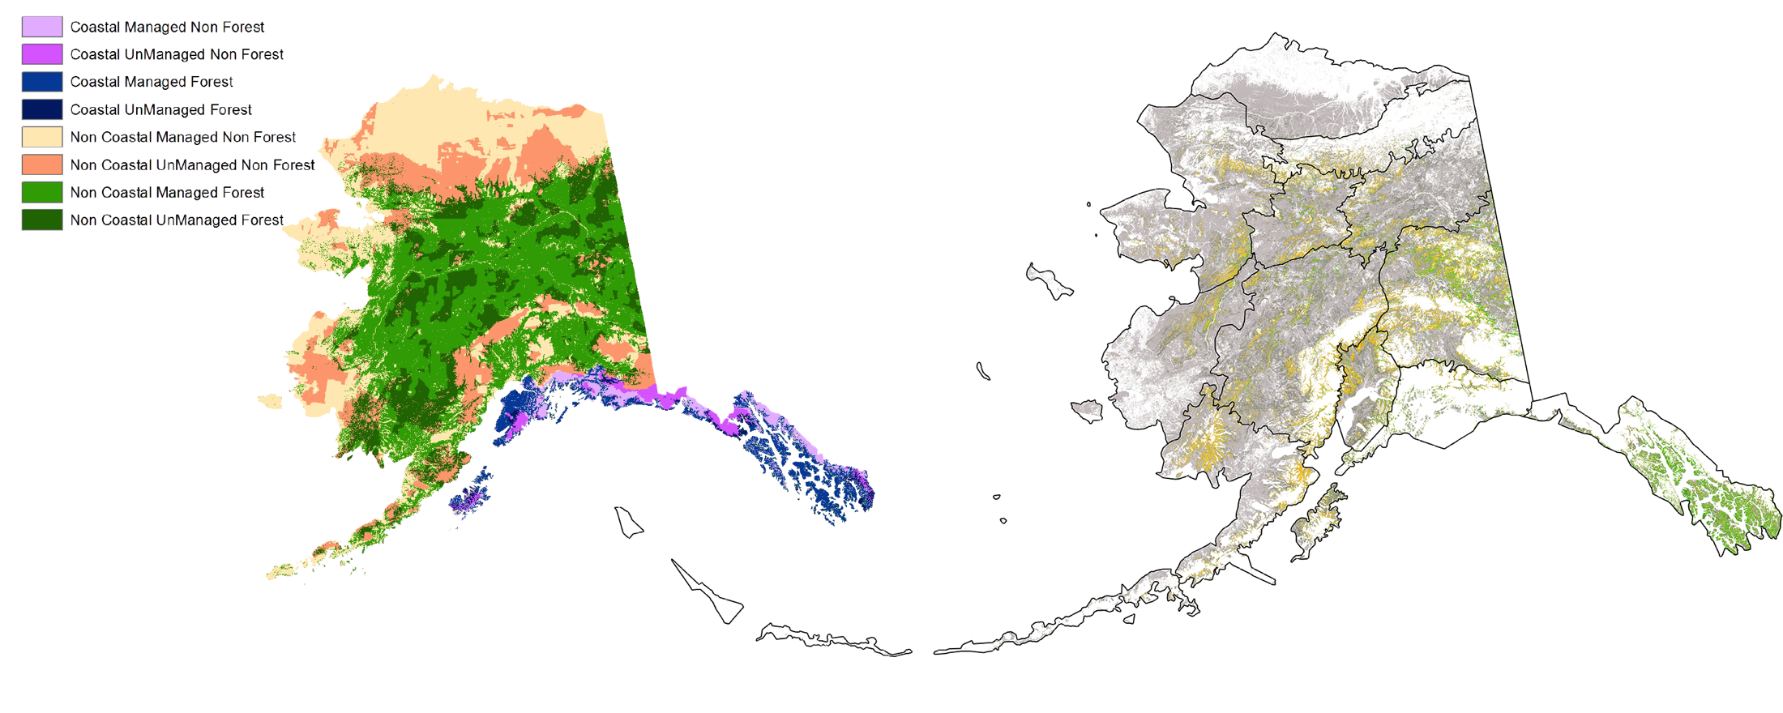
Alaska’s Forest Biomass Distribution
Carbon Stored in Managed and Unmanged Forests of Alaska at 1-ha
Saatchi and Woodall et al.

Slide 23
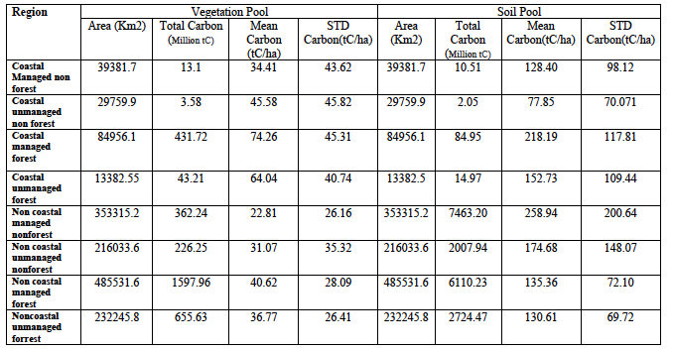
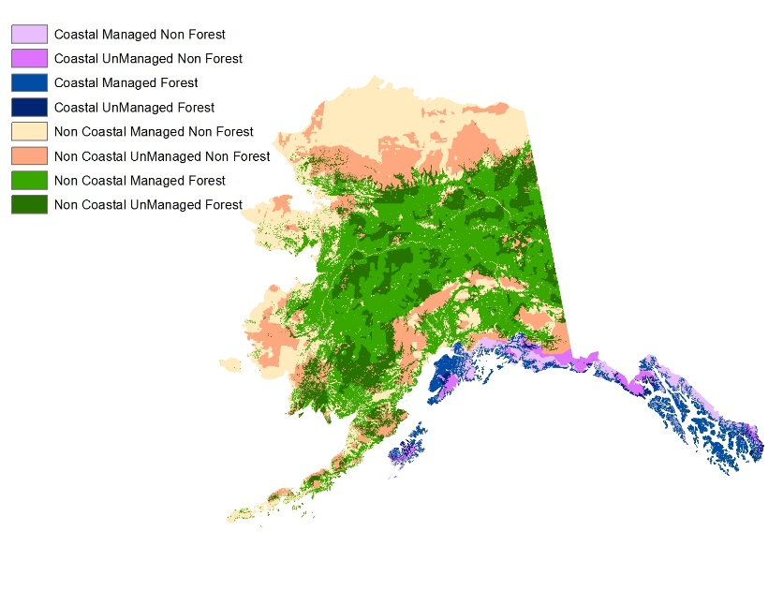
Carbon Pools in Forests of Alaska
Carbon pools in vegetation include
AGB, BGB, CWD, and LTR
Soil Carbon includes 1 m depth
organic soil carbon.
Saatchi and Woodall et al.

Slide 24
In Prep Manuscripts
Attributed carbon flux in US Forestlands between 2005-2010. Hagen et al
Tracking uncertainty in forest carbon stocks and fluxes within an MRV context. Hagen et al
Mapping Stand Ages of Primary Forests in Northern Hemisphere Using Remote Sensing Data. Zhang & Ganguly et al

Slide 25
Questions/Contact
Sassan Saatchi: sassan.Saatchi@jpl.nasa.gov;
Stephen Hagen: shagen@appliedgeosolutions.com; 603-292-1189
Sangram Ganguly: sangram.ganguly@nasa.gov; 617-319-6249

Slide 26
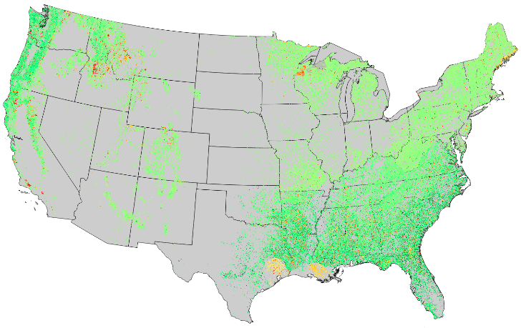
Multiple Scales
Net Flux: 1 ha
Net Flux: County

Slide 27
Multiple Scales
Net Flux: 1 ha

